Slide 1
Introduction
CHAPTER 1
Wim.VandenBreen@UGent.be

Slide 2
The Digital Computer
Machine to carry out instructions
  A program
Instructions are simple
  Add numbers
  Check if a number is zero
  Copy data between memory locations
Primitive instructions in machine language

Slide 3
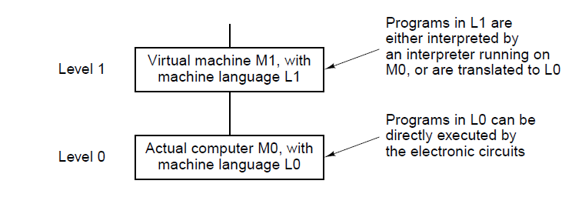
Languages, Levels, and Virtual Machines (1)
. . .

Slide 4
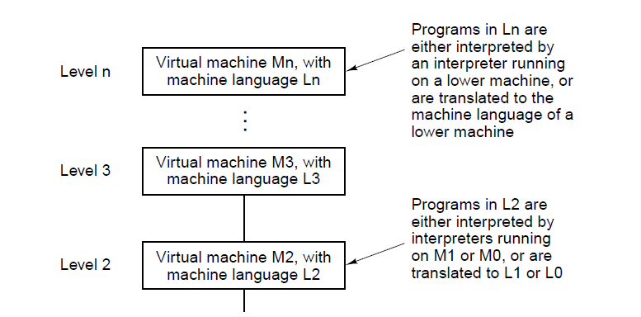
Languages, Levels, and Virtual Machines (2)
Figure 1-1. A multilevel machine.
. . .

Slide 5
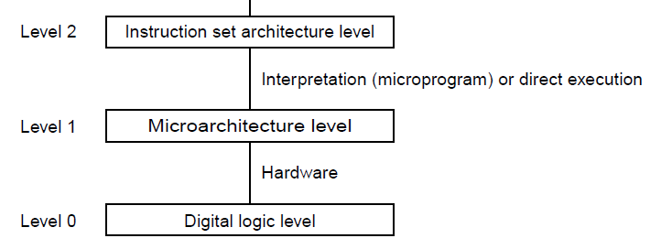
Contemporary Multilevel Machines (1)
. . .

Slide 6
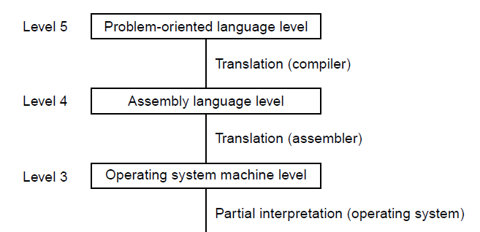
Contemporary Multilevel Machines (2)
. . .

Slide 7
Evolution of Multilevel Machines
Invention of microprogramming
Invention of operating system
Migration of functionality to microcode
Elimination of microprogramming

Slide 8
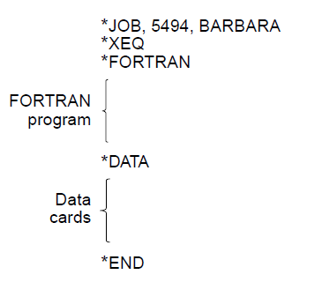
Operating System Tasks

Slide 9
Increased Functionality in Microcode (1)
Instructions for integer multiplication and division
Floating-point arithmetic instructions
Instructions for calling and returning from procedures
Instructions for speeding up looping
Instructions for handling character strings
Indexing and indirect addressing
Relocation facilities
Interrupt systems
Process switching
Processing audio, image, multimedia files

Slide 10
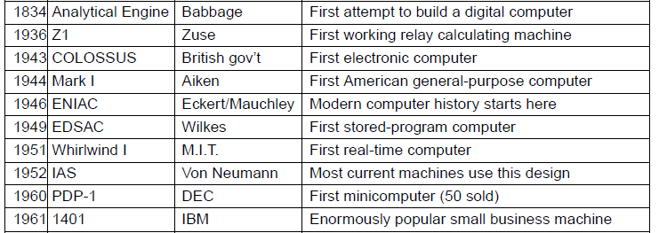
Milestones (1)
. . .

Slide 11
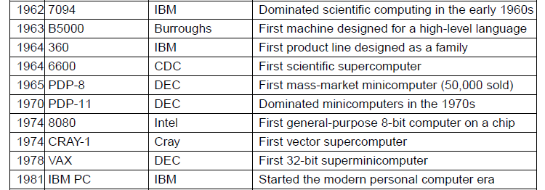
Milestones (2)
. . .

Slide 12
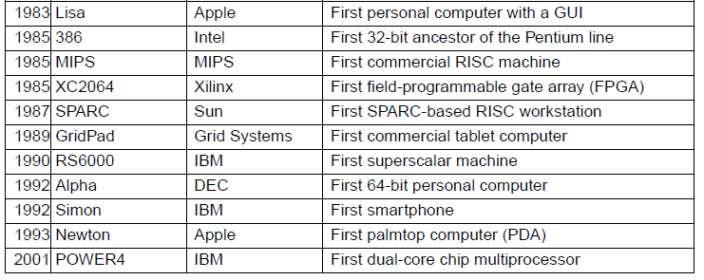
Milestones (3)

Slide 13
Computer Generations
Zeroth Generation Mechanical Computers (1642 – 1945)
First Generation Vacuum Tubes (1945 – 1955)
Second Generation Transistors (1955 – 1965)
Third Generation Integrated Circuits (1965 – 1980)
Fourth Generation Very Large Scale Integration (1980 – ?)
Fifth Generation Low-Power and Invisible Computers

Slide 14
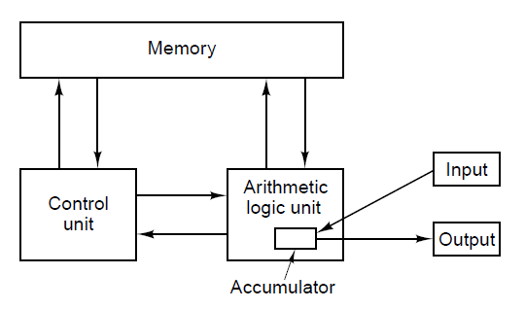
von Neumann Machine
Figure 1-5. The original von Neumann machine.

Slide 15
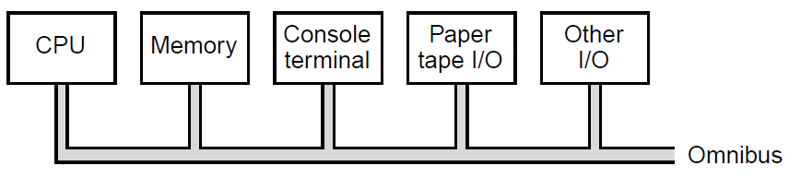
PDP-8 Innovation – Single Bus

Slide 16
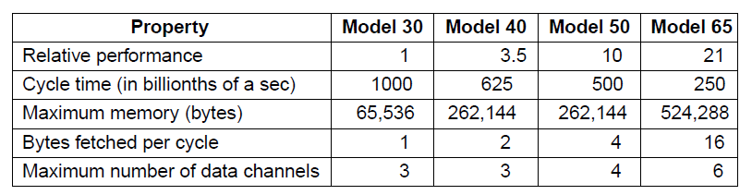
IBM 360

Slide 17
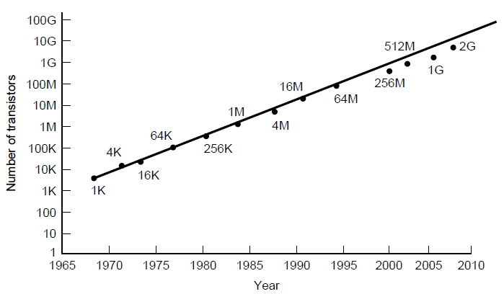
Technological and Economic Forces
Moore’s law predicts a 60 percent annual increase in the number of transistors that can be put on a chip.

Slide 18
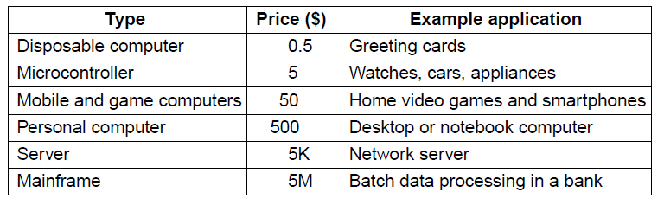
The Computer Spectrum (1)

Slide 19
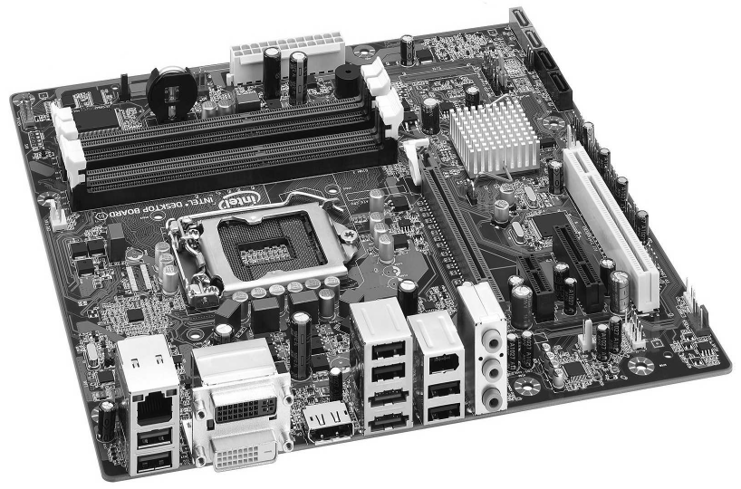
The Computer Spectrum (2)

Slide 20
Microcontrollers
Appliances
Communications gear
Computer peripherals
Entertainment devices
Imaging devices
Medical devices
Military weapon systems
Shopping devices
Toys

Slide 21
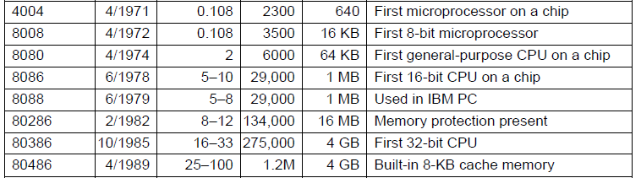
Introduction to the x86 Architecture (1)
. . .

Slide 22
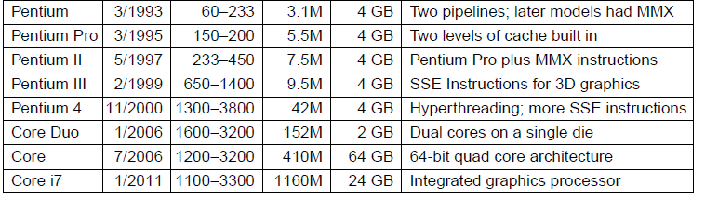
Introduction to the x86 Architecture (2)

Slide 23
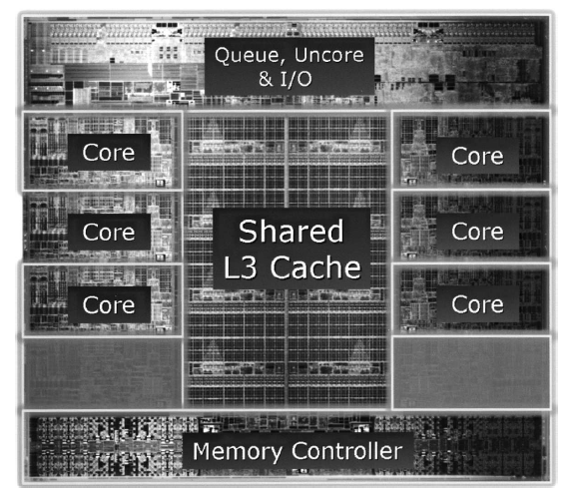
Introduction to the x86 Architecture (3)
The Intel Core i7-3960X die. The die is 21 by 21 mm and has 2.27 billion transistors.

Slide 24
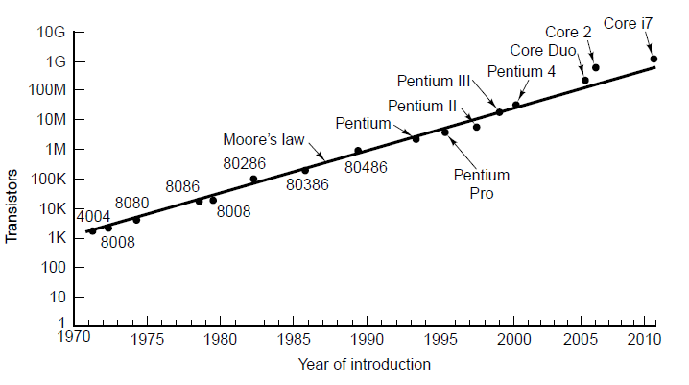
Introduction to the x86 Architecture (4)
Moore’s law for (Intel) CPU chips.

Slide 25
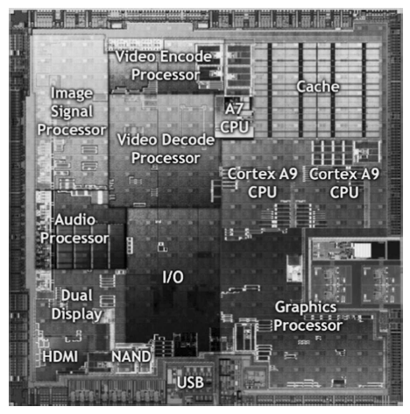
Introduction to the ARM Architecture
The Nvidia Tegra 2 system on a chip.

Slide 26
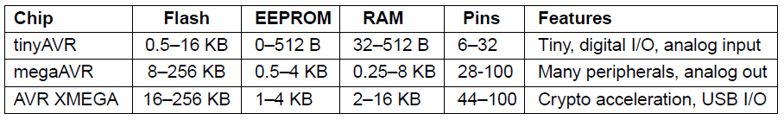
Introduction to the AVR Architecture

Slide 27
Peripherals in the Atmel megaAVR-168
Three timers
Real-time clock with oscillator
Six pulse-width modulation channels
Eight analog-to-digital conversion channels
Universal serial receiver/transmitter
I2C serial interface
Programmable watchdog timer
On-chip analog comparator
Power brown-out detector
Internal programmable clock oscillator

Slide 28
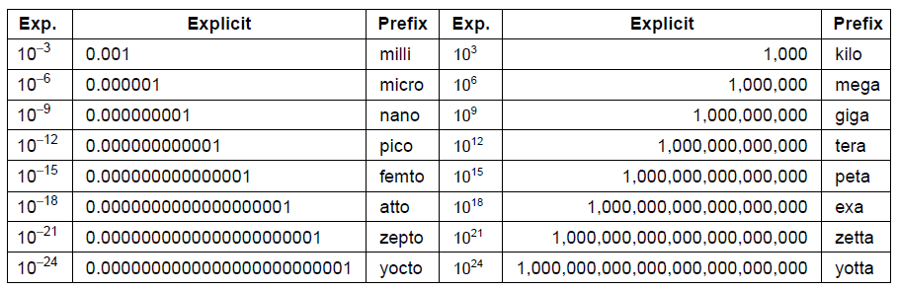
Metric Units
Figure 1-16. The principal metric prefixes.

